Slide 1

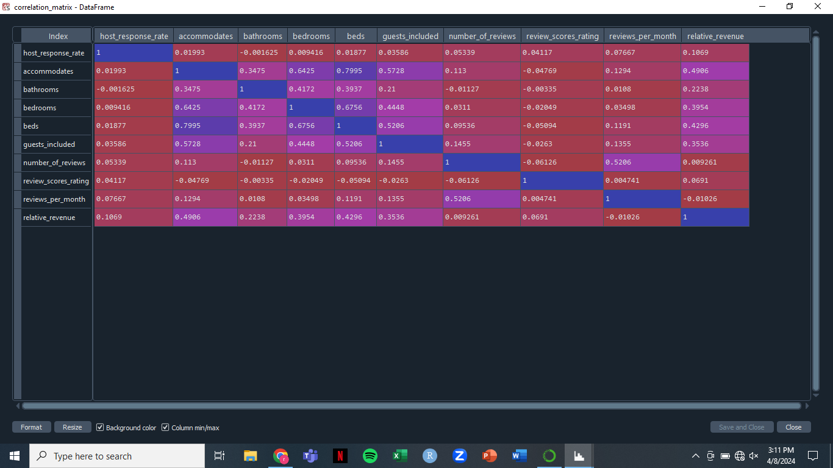
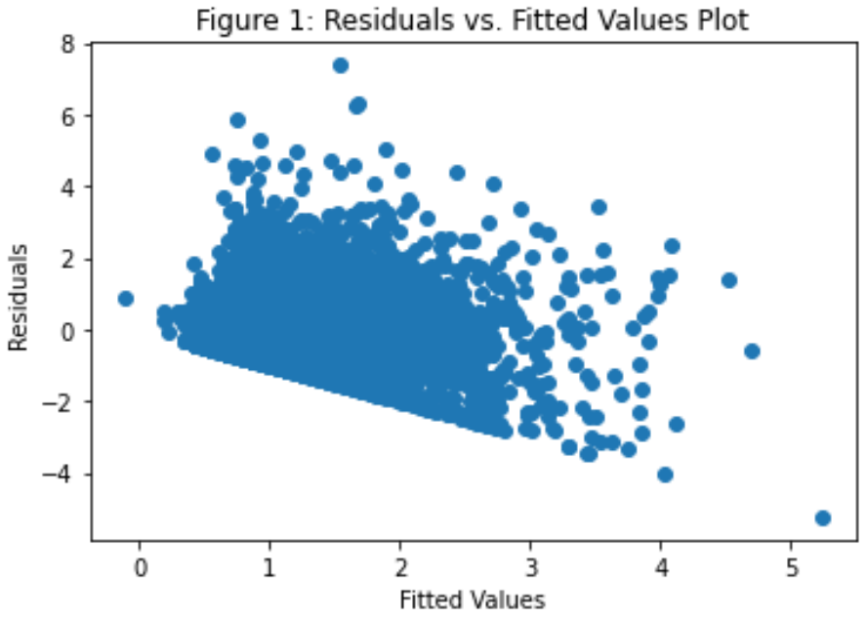
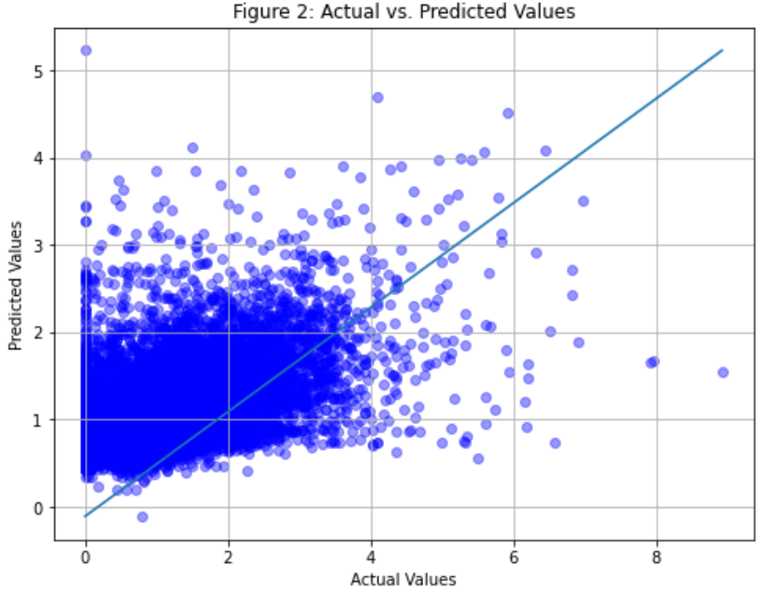
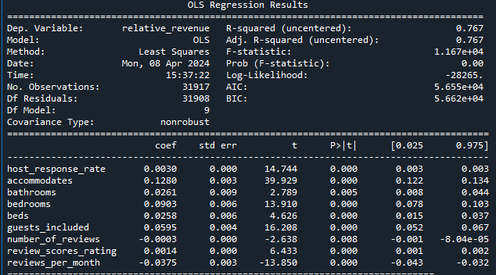


Maximizing Revenue for Airbnb
Rebekah Sander – Anticipated Graduation May 2024
INTRODUCTION
Advisors: Dr. Marla Bell, Jitendra Sai Kota
Results
The goal of this project is to analyze how an Airbnb host could maximize their monthly revenue with respect to their location.
This 2017 Airbnb dataset consisted of 44,318 different Airbnb’s located in New York City, and the values are those of a particular month.
The dataset originally included 31 variables. 12 of those variables were used, and only 10 variables went into the model.
A multiple linear regression model was used to make predictions of monthly revenue relative to the neighborhood based off of quantitative characteristics.
Table 1: Correlation Matrix
Correlations
According to the correlation matrix, the variables, 'accommodates,' 'bedrooms,' 'beds,' and 'guests_included,' have a moderate correlation with relative revenue, suggesting they play a significant role in predicting revenue
Model Usefulness
The model showed a strong statistical significance, with an F-statistic of 11,670 and a p-value below 0.001. At the 5% significance level, our model has something valuable to offer in predicting relative revenue.
All the variables included in the model proved to be statistically significant, as each coefficient had a p-value below 0.05.
Evaluation Metrics
Adjusted R-squared = 0.7669
RMSE = 0.5826
METHODS
Pre-Processing
Missing values in each column were imputed using the median of the respective column to maintain data integrity.
Duplicates were identified by analyzing entire rows or columns and were then dropped to ensure data accuracy.
Datatypes that were read as objects but should have been numeric were corrected to ensure consistency and facilitate analysis.
Feature Engineering
The target variable, 'relative_revenue,' was engineered using three variables--'price,' 'availability_30,' and 'neighbourhood_cleansed.' Monthly revenue was standardized using neighborhood as a reference, recognizing the significance of location in revenue generation. Subsequently, all other categorical features were dropped for this analysis.
Outliers outside of 3 standard deviations from the mean were identified and removed to prevent them from skewing the analysis.
Prior to model training, the dataset was split into training and test sets using an 80:20 ratio to evaluate model performance effectively.
The Model
A multiple linear regression model was selected for its suitability in analyzing the relationship between multiple independent variables and a continuous dependent variable.
The multiple linear regression model was trained using the training dataset.
The trained model was assessed for usefulness and the significance of coefficients. It then was applied to the test dataset to evaluate its performance using metrics such as adjusted R-squared and root mean square error.
Discussion
Note that ‘neighbourhood_cleansed’ was the only categorical variable used in this analysis. Though it was not directly in the model, using this variable to calculate ‘relative_revenue’ was imperative. Location is everything when owning a business. Different locations in New York City will not only be worth different amounts, but also will have different demands. By adjusting monthly revenue based on neighborhood averages, we could better compare performance across locations.
Initially, all available variables were used to find the best model with the right settings. However, the resulting models showed similar performance in not providing significant insights. With more time and expertise, a more comprehensive model considering all variables might have been more fruitful.
One big limitation of this analysis is that it might not apply well to other locations. There are different types of attractions wherever a person may travel. To improve future studies, including more geographic and demographic factors may make the model more widely applicable.
Table 2: Model Results
PYTHON CODE
GitHub: https://shorturl.at/enxGU

